Slide 1
SOF 103
C and C++ Programming
Chapter 01 - 03
Extended Topics
Compiled by Dr.Hew

Slide 2
Vision and Mission
Vision
Xiamen University Malaysia aspires to become a university with a distinct global outlook, featuring first-class teaching and research, and embracing cultural diversity.
Mission
To nurture young talents with dignity and wisdom, turning them into fine citizens of the region who will contribute to the prosperity of the people and social progress of Malaysia, China and Southeast Asia.
Operators and Control Structures II

Slide 3
What have you learned?
  So Far…
  What have you learned?
Operators and Control Structures II

Slide 4
Last week review
  1)
  if(marks >= 60)
  cout<<“You are pass”;
  2)
  if(marks >= 60)
  cout<<“You are pass”;
  else
  cout<<“You are fail”;
Operators and Control Structures II

Slide 5
Last week review
  1)
  int marks=70;
  if(marks >= 90)
  cout<<"A";
  else if(marks >= 80)
  cout<<"B";
  else if(marks >= 70 )
  cout<<"C";
  else if(marks >= 60 )
  cout<<"D";
  else
  cout<<"Fail";
Operators and Control Structures II

Slide 6
Last week review
  1)
  int choice=3;
  switch(choice)
  {
  case 1: cout<<"Menu 1"; break;
  case 2: cout<<"Menu 2"; break;
  case 3: cout<<"Menu 3"; break;
  case 4: cout<<"Menu 4"; break;
  default: cout<<"Invalid choice!!!";
  }
Operators and Control Structures II

Slide 7
Last week review
  1)
for(int i = 1; i<=10;i++)
cout<<i<<endl;
2)
int num, sum=0;
char ch='y';
while(ch == 'y')
{
cout<<"Enter number to add ";
cin>>num;
sum = sum + num;
cout<<"do you want to add next number ? (y or n)";
cin>>ch;
}
cout<<"The sum is "<<sum;
Operators and Control Structures II

Slide 8
Last week review
  1)
int num, sum=0;
char ch;
do
{
cout<<"Enter number to add ";
cin>>num;
sum = sum + num;
cout<<"do you want to add next number ? (y or n)";
cin>>ch;
}while(ch == 'y');
cout<<"The sum is "<<sum;
Operators and Control Structures II

Slide 9
Chapter Overview
Type Conversion
Working With Characters and Strings Objects
Hand Tracing a Program
Comparing Characters and Strings
The Conditional or Ternary Operator
Using “while loop” For Input Validation
“for loop” Modifications
Keeping a Running Total
Sentinels
Deciding Which Loop to Use
Nested Loops
Set precision
Operators and Control Structures II

Slide 10
1. Type Conversion
Operations are performed between operands of the same type.
If not of the same type, C++ will convert one to be the type of the other
This can impact the results of calculations.
Operators and Control Structures II

Slide 11
Type Convertion
1) There are two types of type conversion in C++.
Implicit Conversion
Explicit Conversion (also known as Type Casting)
Operators and Control Structures II

Slide 12
Implicit Type Conversion?
➔The type conversion that is automatically done by the compiler
Operators and Control Structures II

Slide 13
Example
int x, y = 4;
float z = 2. 7;
x = y * z;
In the expression y * z, y will be promoted to float and 10.8 will result from the multiplication. Since x is an integer, however, 10.8 will be truncated and 10 will be stored in x.
Operators and Control Structures II

Slide 14
Explicit Conversion (Type Casting)
Used for manual data type conversion
Useful for floating point division using ints: double m;
m = static_cast<double>(y2-y1)
/(x2-x1);
Useful to see int value of a char variable:
char ch = 'C';
cout << ch << " is "
<< static_cast<int>(ch);
Operators and Control Structures II

Slide 15
C-Style and Prestandard Type Cast Expressions
C-Style cast: data type name in ()
cout << ch << " is " << (int)ch;
Prestandard C++ cast: value in ()
cout << ch << " is " << int(ch);
Both are still supported in C++, although
static_cast is preferred
Operators and Control Structures II

Slide 16
2. Working With Characters and Strings Objects
Using cin with the >> operator to input strings can cause problems:
It passes over and ignores any leading whitespace characters (spaces, tabs, or line breaks)
To work around this problem, you can use a C++ function named getline.
Operators and Control Structures II

Slide 17
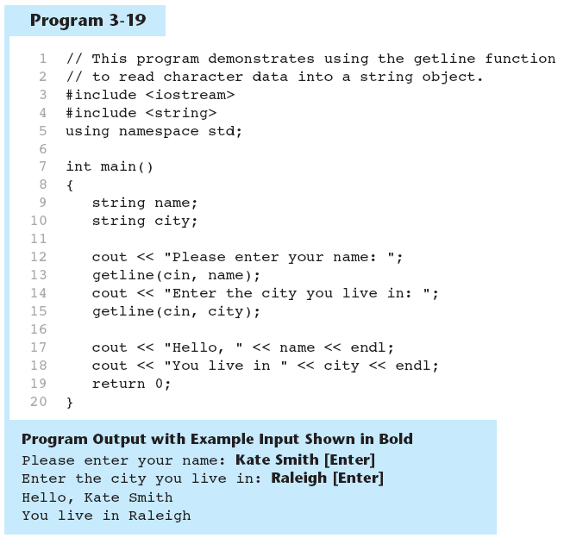
Using getline
Operators and Control Structures II

Slide 18
Cont…
To read a single character:
  Use cin:
    char ch;
    cout << "Strike any key to continue";
    cin >> ch;
    Problem: will skip over blanks, tabs, <CR>
  Use cin.get():
    cin.get(ch);
    Will read the next character entered, even
    whitespace
Operators and Control Structures II

Slide 19
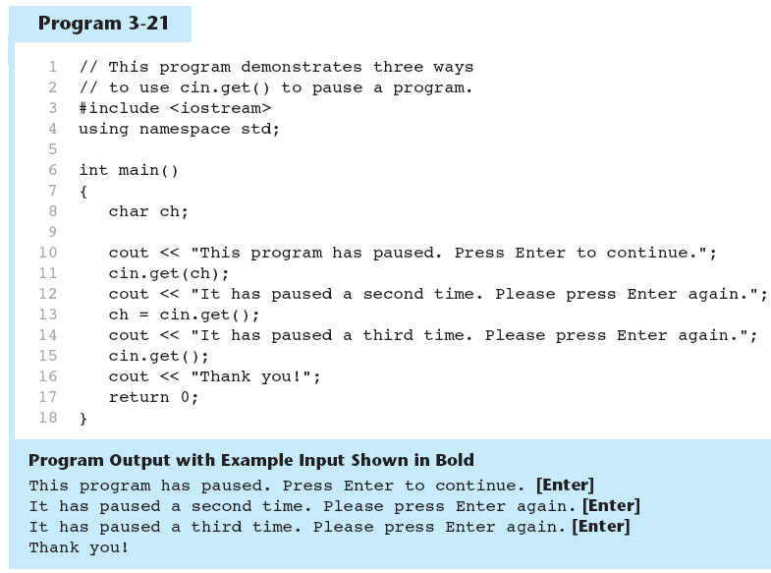
Using cin.get in a Program
Operators and Control Structures II

Slide 20
Mixing cin and cin.get
Mixing cin >> and cin.get() in the same program can cause input errors that are hard to detect
To skip over unneeded characters that are still in the keyboard buffer, use cin.ignore():
  cin.ignore(); // skip next char
  cin.ignore(10, '\n'); // skip the next
  // 10 char. or until a '\n'
Operators and Control Structures II

Slide 21
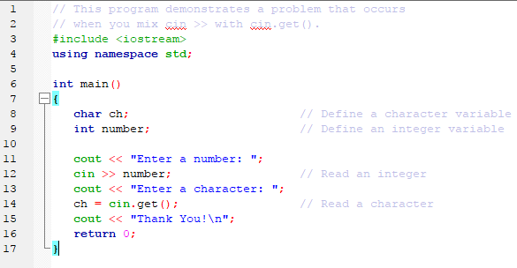
Mixing cin and cin.get – Cont…
Operators and Control Structures II

Slide 22
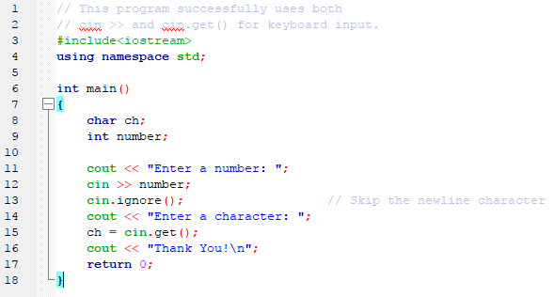
Mixing cin and cin.get - Fix
Operators and Control Structures II

Slide 23
String Member Functions and Operators
To find the length of a string:
To concatenate (join) multiple strings:
string state = "Texas";
int size = state.length();
greeting2 = greeting1 + name1;
greeting1 = greeting1 + name2;
Or using the += combined assignment operator:
greeting1 += name2;
Operators and Control Structures II

Slide 24
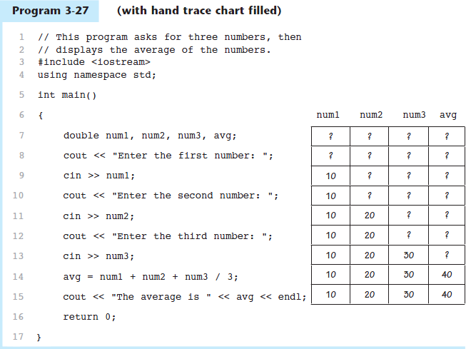
3. Hand Tracing a Program
Operators and Control Structures II

Slide 25
4. Comparing Characters and Strings
Characters are compared using their ASCII values
'A' < 'B'
  The ASCII value of 'A' (65) is less than the ASCII value of 'B'(66)
'1' < '2'
  The ASCII value of '1' (49) is less than the ASCI value of '2' (50)
Lowercase letters have higher ASCII codes than uppercase letters, so 'a' > 'Z'
Operators and Control Structures II

Slide 26
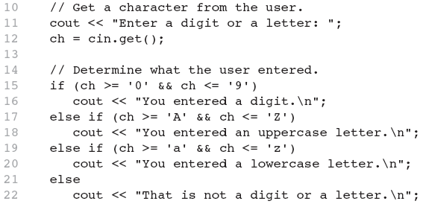
Comparing Characters Using Relational Operators
Operators and Control Structures II

Slide 27
Comparing String Objects
Like characters, strings are compared using their ASCII values
string name1 = "Mary";
string name2 = "Mark";
name1 > name2 // true
name1 <= name2 // false
name1 != name2 // true
name1 < "Mary Jane" // true
Operators and Control Structures II

Slide 28
5. The Conditional or Ternary Operator
Can be used to create short if/else statements
Format: expr ? expr : expr;
x<0 ? (y=10) : z=20;
First Expression:
Expression to be
tested
2nd Expression:
Executes if first
expression is true
3rd Expression:
Executes if the first
expression is false
Operators and Control Structures II

Slide 29
Conditional Operator – Cont…
The value of a conditional expression is
  The value of the second expression if the first expression is true
  The value of the third expression if the first expression is false
Parentheses()may be needed in an expression due to precedence of conditional operator
Operators and Control Structures II

Slide 30
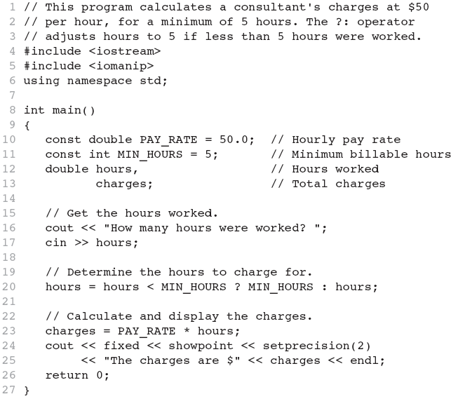
Program:
Operators and Control Structures II

Slide 31
6. Using “while loop” For Input Validation
Input validation is the process of inspecting data that is given to the program as input and determining whether it is valid.
The while loop can be used to create input routines that reject invalid data, and repeat until valid data is entered.
Operators and Control Structures II

Slide 32
Input Validation - Cont…
Here is the general approach, in pseudo-code
Read an item of input.
While the input is invalid
Display an error message.
Read the input again.
End While
Operators and Control Structures II

Slide 33
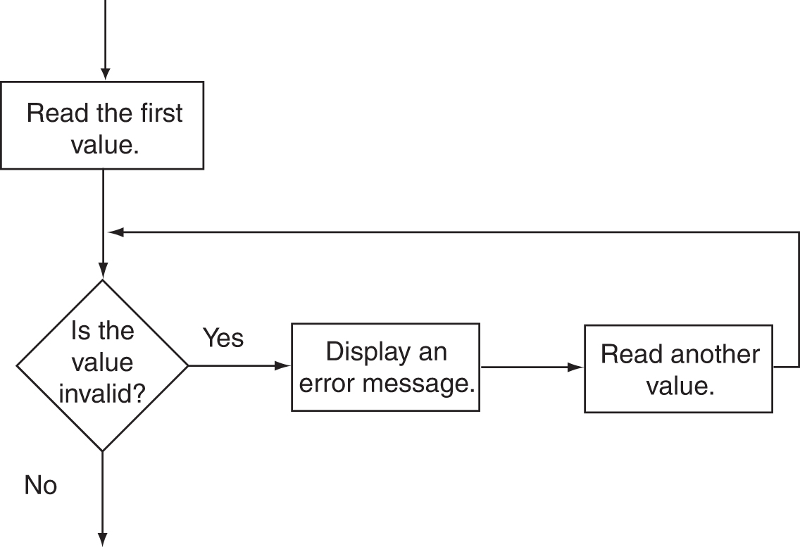
Flowchart For Input Validation
Operators and Control Structures II

Slide 34
Input Validation Example-1
int main()
{
int number;
cout<<"Please enter a number less than 10: ";
cin>>number;
while(number>=10)
{
cout<<"Invalid Entry!\n";
cout<<"Please enter a number less than 10: ";
cin>>number;
}
return 0;
}
Operators and Control Structures II

Slide 35
Input Validation Example-2
Asking for a number in the range 0 – 100
int number;
cout << "Please enter a number in the range 0 - 100 ";
cin >> number;
while (number <0 || number >100)
{
cout << "ERROR: Please enter a valid number: ";
cin >> number;
}
Operators and Control Structures II

Slide 36
7. “for loop” Modifications
You can have multiple statements in the initialization expression. Separate the statements with a comma:
int x, y;
for (x=1, y=1; x <= 5; x++)
{
cout << x << " plus " << y
<< " equals " << (x+y)
<< endl;
}
Initialization Expression
Operators and Control Structures II

Slide 37
“for loop” Modifications – Cont…
You can also have multiple statements in the increment expression. Separate the statements with a comma:
int x, y;
for (x=1, y=1; x <= 5; x++, y++)
{
cout << x << " plus " << y
<< " equals " << (x+y)
<< endl;
}
increment Expression
Operators and Control Structures II

Slide 38
“for loop” Modifications – Cont…
You can omit the initialization expression if it has already been done:
int sum = 0, num = 1;
for (; num <= 10; num++)
sum += num;
Operators and Control Structures II

Slide 39
8. Keeping a Running Total
Running total: accumulated sum of numbers from each repetition of loop
Accumulator: variable that holds running total
  int sum=0, num=1; // sum is the accumulator
  while (num <= 10) {
  sum += num;
  num++;
  }
  cout << "Sum of numbers 1 – 10 is"
  << sum << endl;
Operators and Control Structures II

Slide 40
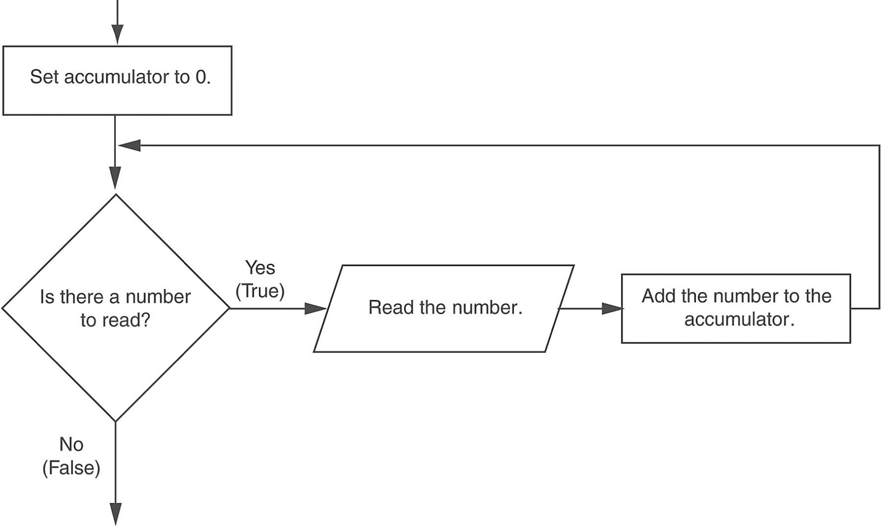
Logic for Keeping a Running Total
Operators and Control Structures II

Slide 41
9. Sentinels
Sentinel: value in a list of values that indicates end of data
Special value that cannot be confused with a valid value, e.g., -999 for a test score
Used to terminate input when user may not know how many values will be entered
Operators and Control Structures II

Slide 42
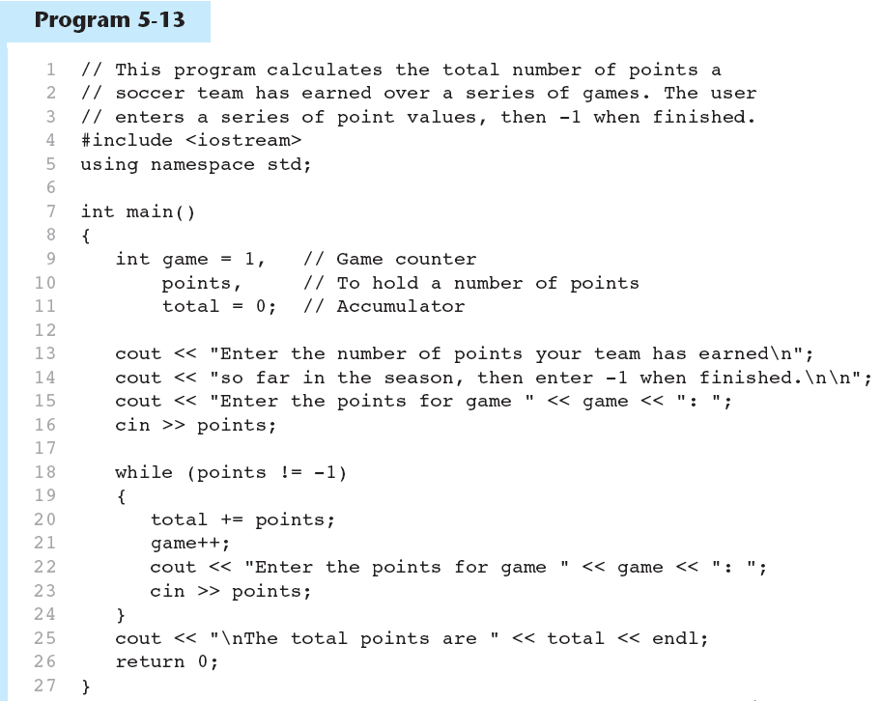
A Sentinel in a Program
Operators and Control Structures II

Slide 43
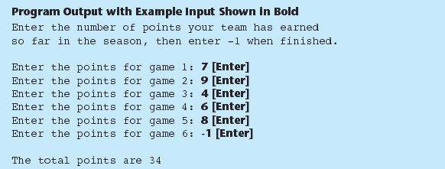
Sentinel – Program Output
Operators and Control Structures II

Slide 44
10. Deciding Which Loop to Use
The while loop is a conditional pretest loop
  Iterates as long as a certain condition exits
  Validating input
  Reading lists of data terminated by a sentinel
The do-while loop is a conditional posttest loop
  Always iterates at least once
  Repeating a menu
The for loop is a pretest loop
  Built-in expressions for initializing, testing, and updating
  Situations where the exact number of iterations is known
Operators and Control Structures II

Slide 45
11. Nested Loops
A nested loop is a loop inside the body of another loop
Inner (inside), outer (outside) loops:
  for (row=1; row<=3; row++) //outer
  for (col=1; col<=3; col++) //inner
  cout << row * col << endl;
Operators and Control Structures II

Slide 46
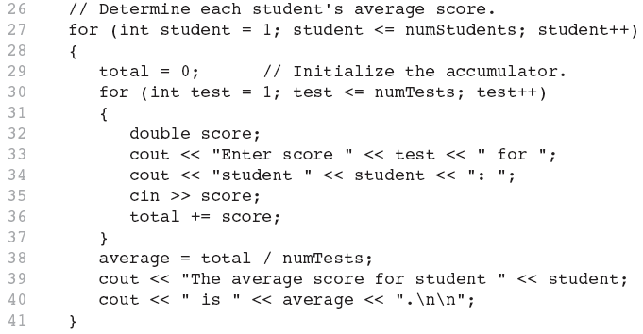
Nested Loop – Code Snippet
Operators and Control Structures II

Slide 47
Nested Loops - Notes
Inner loop goes through all repetitions for each repetition of outer loop
Inner loop repetitions complete sooner than outer loop
Total number of repetitions for inner loop is product of number of repetitions of the two loops.
Operators and Control Structures II

Slide 48
setprecision, fixed
#include <iostream>
#include <iomanip>
using namespace std;
int main(){
int h;
double hourRate, totalPay;
while(1){
cout << "Enter hours worked (-1 to end): ";
cin >> h;
if(h == -1) break;
cout << "Enter hourly rate of the worker ($00.00) = ";
cin >> hourRate;
if(h <= 40) totalPay = hourRate * h;
else totalPay = 40 * hourRate + (h - 40) * hourRate * 3 / 2;
cout << "Salary is " << setprecision(2) << fixed << totalPay << endl;
}
return 0;
}
Operators and Control Structures II

Slide 49
References
  Problem Solving with C++ (10th Edition), Walter Savitch, Addison Wesley, 2018
  Paul J. Dietel, C++ How to Program (10th Edition), Pearson, 2017.
  Turbo C programming for the PC, Robert Lafore
  Dr. Kamran’s notes.
Operators and Control Structures II

